Slide 1
The responsible flushing Alliance
presents
Bathroom bootycamp
Flush Smart Campaign 2026

Slide 2
JOIN US IN CELEBRATING
FLUSH SMART MONTH
WHAT’S INCLUDED IN THE TOOLKIT:
How RFA is Celebrating…………...........................................................................3
Bathroom Bootycamp 7-Day Challenge………………………………………….6
Blog Template….....................................................................................…………………7
Social Guidance….....................................................................................………………8
Op-Ed Template….....................................................................................…………….16
Newsletter Blurb….....................……………...............................................................18​
Engagement Tips and Ideas............................................................................19
#FLUSHSMART

Slide 3

HOW RFA IS CELEBRATING
RFA’s approach is to think outside of the box to ensure our message breaks into the cultural narrative and sticks in the minds of our audiences.
Each year, RFA’s #FlushSmart campaign evolves, reflecting new insights into consumer behavior and flushing habits. This year, we dove further into the knowledge that poor bathroom habits are a major point of contention in relationships today.
This year, our annual #FlushSmart campaign is ready to whip everyone into better bathroom shape with our Bathroom Bootycamp. We’re aiming to strengthen relationships and improve flushing practices by testing knowledge and building smarter habits.
#FLUSHSMART

Slide 4
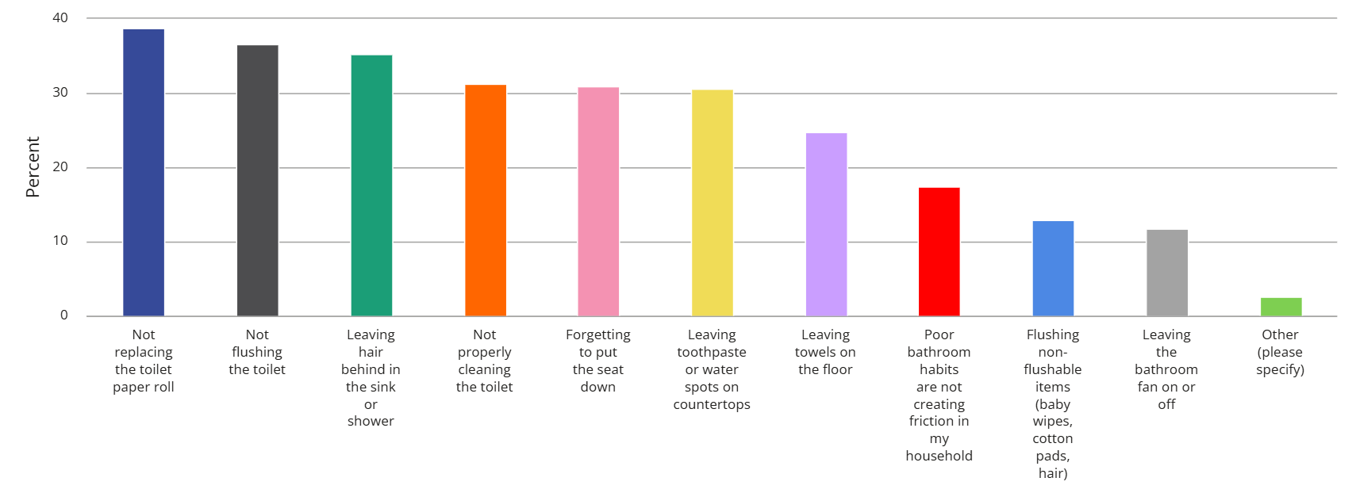
HOW RFA IS CELEBRATING
We surveyed over 1,300 Americans to find out which habits bother people most. Some of the top offenses include not replacing the toilet paper roll (38.9%), leaving hair in sinks and showers (35.3%), and flushing non-flushable items down the toilet (13.9%).
We know that flushing confusion persists, with paper towels (18%), baby wipes (16%), cleaning wipes (10%), and tampons (15%) still commonly perceived as flushable even though they are not.
#FLUSHSMART

Slide 5
HOW RFA IS CELEBRATING
HOW IT WORKS:
Building on our successful influencer engagements from last year, #FlushSmart 2026 will deploy two engaging influencer strategies: #GetFlushSmart will bring family-friendly challenges into homes, while Reporting for Doody will feature a "doody sergeant" quizzing participants on proper flushing behavior in public. These activations are designed to heighten awareness and reinforce critical flushing education.
This toolkit offers a range of flexible resources and customizable assets, specifically designed to empower wastewater agencies and our members. While our influencer content drives broad consumer engagement, this toolkit ensures you can adapt and leverage key messages, tackle common misconceptions, and champion the Do Not Flush symbol in ways that best suit your unique audiences and operational needs.
JOIN THE FUN:
Get ready to train for smart flushing! Follow @FlushSmart on social media during Flush Smart Month in July to see the Bathroom Bootycamp influencer content in action. We encourage you to utilize the versatile resources within this toolkit to become a "Bootycamp" leader in your own right, sharing vital information, dispelling misinformation, and encouraging your networks to #FlushSmart. Together, we can build stronger pipes and stronger relationships!
#FLUSHSMART

Slide 6
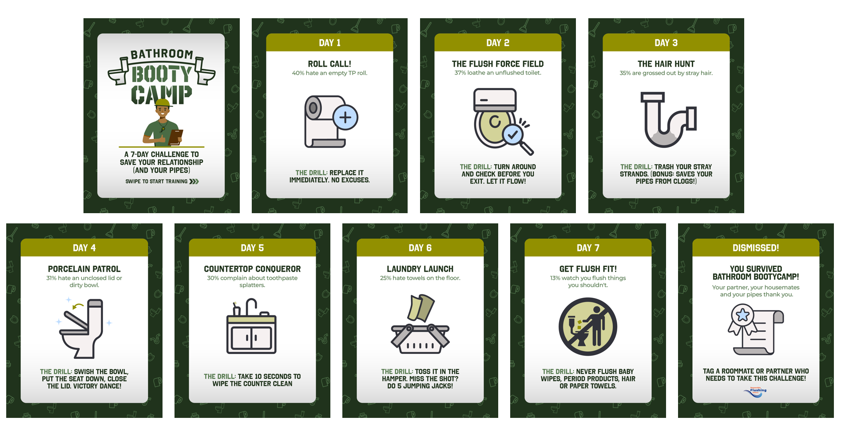
Bathroom bootycamp
7-Day challenge
Are your gross bathroom behaviors putting your relationships at risk? You’re not alone — poor bathroom habits are a major point of contention in many relationships. We at the Responsible Flushing Alliance wanted to learn more, so we asked more than 1,300 Americans which bathroom habits got under their skin the most. What we found surprised us, so we developed the Bathroom Bootycamp to help you save your relationships (or your housemates’ sanity)!
Over the next 7 days, we’ll tackle the biggest bathroom pet peeves with fun challenges and smart tips. Let’s whip those habits into shape!
Download Challenge
Download Social Carousel

Slide 7
BATHROOM BOOTYCAMP 7-DAY CHALLENGE BLOG TEMPLATE
Happy Flush Smart Month! How Flush Fit Are You?
July is Flush Smart Month. As [add organization’s tie-in to flushing, e.g., a brand dedicated to creating convenient, safe products for use in the bathroom/an organization dedicated to ensuring efficient wastewater management in our community], we keep smart flushing top of mind.
And with major sewage disasters making headlines this year, it’s high time we all started paying closer attention.
Around 850 million gallons of raw sewage enter America’s waterways every year, driven by aging infrastructure pushed well beyond its limits. [Add relevant local infrastructure age or condition stats if available.]
The good news? Everyone can help — simply by being more mindful of what goes down the drain. Flushing the wrong items causes blockages, pressure buildups, and ultimately, leaks. Raw sewage carries bacteria, viruses, parasites, and chemicals that contaminate rivers, lakes, and oceans — endangering wildlife and public health alike. [Reference a local waterway, beach closure, or wildlife impact if relevant.]
Want to help make a positive impact? Take the Bathroom Bootycamp 7-Day Challenge to make flushing smart a natural, easy part of your everyday life.
[ADD INFOGRAPHIC]
Small habits, big impact. This Flush Smart Month — and every month — do your part. Always check for the DO NOT FLUSH symbol and think before anything goes down the drain. [Optional closing call-to-action, e.g., “Starting this month, talk to your family or friends about how they too can get Flush Fit to build lasting, smart flushing habits.”]

Slide 8
SOCIAL GUIDANCE
Throughout July, RFA will be publishing educational content around Flush Smart Month teaching folks about the importance of responsible flushing.
We encourage you to follow along by engaging with our content and developing some of your own! Below is templated copy you can easily paste and publish on your organization’s, company’s or brand’s page. You can also find all asset recommendations on our website, here and here.
Join the Flush Smart Month conversation!
We’re looking for each piece of content to include a short call-to-action (CTA) message to help encourage people to reconsider flushing non-flushable wipes (baby wipes, cleaning wipes, makeup removal wipes). Wipes with the Do Not Flush symbol always go in the trash, never the toilet!
FOLLOW US: Stay up to date with the latest content by joining the community and following us on LinkedIn, Facebook and X.
TAG US: When sharing Flush Smart Month content, please tag RFA and use the hashtag, #FlushSmart. This makes it easier for us to find your content because we want to engage with your posts, too!
LIKE & COMMENT: Engaging with each other’s content will help boost visibility and ultimately help spread the responsible flushing message to a broader audience.
We know responsible flushing is a nuanced conversation, but the more we can keep sharing this message on social media, especially during Flush Smart Month, the more we’re able to strengthen our collective reach and make a difference!

Slide 9
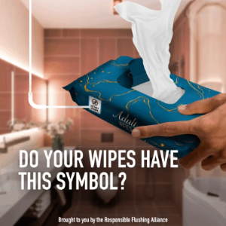
For wastewater and municipal/City entities
Copy | Asset
Copy for X, Facebook, LinkedIn, Instagram: Ready to get Flush Fit? This July, we're challenging you to 7 days of simple, doable actions that help you build smarter flushing habits. One small step a day goes a long way for your home, your pipes, and your community. Let's get started! #FlushSmart https://flushsmart.org/bathroom-bootycamp/ | Suggested Images:
Copy for X, Facebook, LinkedIn, Instagram: Think you know what it means to practice responsible flushing? Test yourself this #FlushSmart Month and take our quiz to find out: https://flushsmart.org/bathroom-bootycamp-quiz | N/A
Copy for X, Facebook, LinkedIn, Instagram: Did you know July is #FlushSmart Month? Now is the perfect time to celebrate, and it’s quite simple: always look for the Do Not Flush label on wipes packaging before flushing anything. If you see it, trash it! Learn more: https://flushsmart.org/ | Suggested Image:

Slide 10
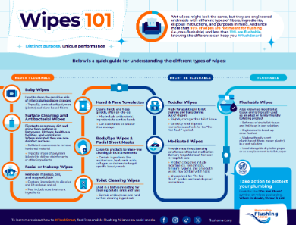
For wastewater and municipal/City entities
Copy | Asset
Copy for X: Big shoutout to [city/region] residents who flush responsibly! 🙌 Non-flushables like paper towels & baby wipes go in the trash — never the toilet. Join us this #FlushSmart Month and only flush the flushable. Learn more: https://flushsmart.org/ Copy for Instagram, Facebook, LinkedIn: Shoutout to every resident in [city/region] who practices responsible flushing! Responsible flushing means keeping non-flushable items, like paper towels and baby wipes, out of our sewage lines. Those products belong in the trash, never the toilet. Become a #FlushSmart expert this month and always check for the Do Not Flush symbol. 🙌 Learn more: https://flushsmart.org/ | Suggested Image:

Slide 11
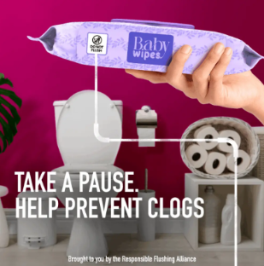
For wastewater and municipal/City entities
Copy | Asset
Copy for X: It's #FlushSmart Month! The best way to celebrate? Check for the Do Not Flush label before you flush anything. See it? Trash it 🗑️— never the toilet. All of us at [insert organization name] thank you! Learn more: https://flushsmart.org/ Copy for Facebook, LinkedIn, Instagram: #FlushSmart Month is here! The best way to celebrate? Always look for the Do Not Flush label before flushing anything. If you ever see that label, make sure you throw it in the trash after use, never the toilet. All of us at [insert organization name] will thank you for it! Learn more: https://flushsmart.org/ | Suggested Image:

Slide 12
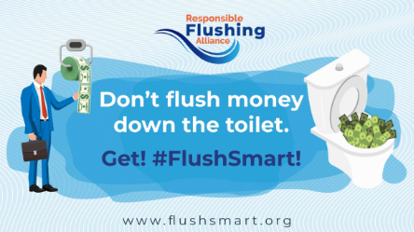
For wastewater and municipal/City entities
Copy | Asset
Copy for X: #FlushSmart Month fact: checking for the Do Not Flush symbol on wipes packaging can help protect our infrastructure & save ratepayers up to $440M a year! Remember to always look at the label and only flush the flushable. https://flushsmart.org/ Copy for Facebook, LinkedIn, Instagram: For #FlushSmart Month we’re sharing the impact of responsible flushing with you – and it’s huge. Following the disposal instructions on wipes packaging by always checking for the Do Not Flush symbol can protect our infrastructure and save ratepayers up to $440 million annually! Help us at [insert organization name] help you and only flush the flushable. https://flushsmart.org/ | Suggested Image:

Slide 13
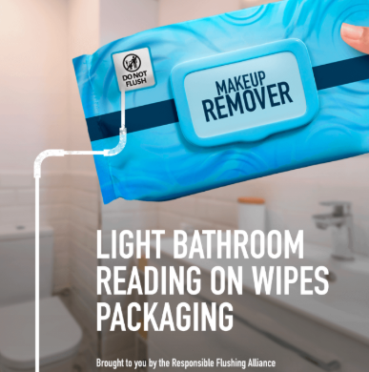
For wastewater and municipal/City entities
Copy | Asset
Copy for X: It's #FlushSmart Month and we need your help! Responsible flushing is just 2 steps: 🧻Check wipes packaging for disposal instructions and the Do Not Flush symbol 🧻Follow those instructions Small actions can make a big impact in [city/region]! https://flushsmart.org/ Copy for Facebook, LinkedIn, Instagram: It’s #FlushSmart Month and we, at [insert organization name], want your help! This month is all about practicing responsible flushing. It’s only two easy steps: 🧻 Check wipes packaging label for disposal instructions, like the Do Not Flush symbol 🧻 Follow those instructions Those small actions help keep [city/region]’s plumbing running smoothly and the community healthy. https://flushsmart.org/ | Suggested Image:

Slide 14
For Brands and Non-Profits
Copy - Companies with flushable products
Copy for X: In partnership with @FlushSmart, we celebrate #FlushSmart Month every July. Responsible flushing is important to us - it’s why we’ve made it clear our wipes are flushable. To learn more about flushability, check out flushsmart.org. Copy for Facebook, LinkedIn, Instagram: Every July we celebrate #FlushSmart Month, an initiative started by our partners at the @Responsible Flushing Alliance. We care deeply about our customers and the products we provide. We take care to ensure our products make disposal instructions clear. You can trust the flushable label as our products have been rigorously tested and meet the required standards. Regardless, always follow the disposal instructions and only flush one wipe at a time. Practicing responsible flushing is bigger than us, it’s about keeping our public infrastructure working and our communities healthy. Learn more at flushsmart.org.
Copy for X: Our wipes aren’t just top quality — they’re clearly labeled flushable, so you always know what’s safe to flush. This #FlushSmart Month, in partnership with @FlushSmart, we all have a part to play. Visit flushsmart.org. Copy for Facebook, LinkedIn, Instagram: Not only do we provide the best products on the market to our customers, we also make sure they’re equipped with the knowledge of how to dispose of them. All our wipes are properly labeled with the flushable label to ensure you know what is safe to flush. During #FlushSmart Month and in partnership with the @Responsible Flushing Alliance, we all have a part to play. Learn more about flushability at https://flushsmart.org/

Slide 15
For Brands and Non-Profits
Copy - Companies with non-flushable products
Copy for X: It's #FlushSmart Month! We make sure our non-flushable wipes are labeled with the proper disposal instructions, including the Do Not Flush symbol, because while our wipes are perfect for [insert use case], they’re not for pipes. Learn more about flushability: flushsmart.org Copy for Facebook, LinkedIn, Instagram: Every July we celebrate #FlushSmart Month, an initiative started by our partners at the @Responsible Flushing Alliance. We care deeply about our customers and the products we provide. We take care to ensure our products have proper disposal labeling with the Do Not Flush symbol, because they are not designed to be flushed and should be thrown in the trash after use. Our products are perfect for [insert product use], but not for the pipes. Practicing responsible flushing is bigger than us, it’s about keeping our public infrastructure working and our communities healthy. Learn more at flushsmart.org.
Copy for X: Our wipes are top quality and have clear disposal instructions on the packaging with the Do Not Flush label, indicating they should be thrown away after use. This #FlushSmart Month, learn about flushabiltiy with our partners at @FlushSmart. Copy for Facebook, LinkedIn, Instagram: Not only do we provide the best products on the market to our customers, we also make sure you’re equipped with the knowledge of how to dispose of them. All our wipes are properly labeled with the Do Not Flush symbol to ensure you know not to flush them after use. During #FlushSmart Month and in partnership with the @Responsible Flushing Alliance, we all have a part to play. Learn more about flushability at https://flushsmart.org/.

Slide 16
Op-Ed Template (p.1)
Our Community is Counting on You to Flush Smart
July is Flush Smart Month. This month, but really every month, protecting our nation’s pipes is something that’s always top of mind for me. And as major sewage disasters have made headlines this year, it’s high time we all start paying more attention.
[Replace or supplement with a local sewage/water quality incident if available.] In January 2026, a busted sewer line in Maryland sent over 200 million gallons of raw sewage into the Potomac River — negatively impacting nearby communities and ecosystems overnight. This isn’t an isolated incident. Around 850 million gallons of raw sewage enter America’s waterways every year, driven by aging infrastructure pushed beyond its limits. [Add relevant local infrastructure age or condition stats if available.]
The good news? Everyone can help — simply by being more mindful of what goes down the drain. Flushing the wrong items can cause pipe blockages, pressure buildups, and ultimately, leaks. Raw sewage carries bacteria, viruses, parasites, and toxic gases that can back-up into homes, contaminate rivers, lakes, and oceans, and can endanger wildlife and public health. [Reference a local waterway, beach closure, or wildlife impact if relevant.]
Follow these three simple steps to protect the pipes in our neighborhoods:
1. Skip the drain for FOGs. Pour cooking fats, oils, and grease into a can and trash it. These items should never go down the sink or toilet, as they can congeal and contribute to clogs.

Slide 17
Op-ed template (pg.2)
2. Check wipes packaging for the Do Not Flush symbol and follow disposal instructions. Ninety percent of wet wipes (like baby wipes, makeup wipes, and cleaning wipes) do not break down in water. Instead, they congeal with FOGs to cause massive clogs. If a wipe isn’t specifically designated as flushable, it will have the Do Not Flush symbol on its packaging and should always go in the trash — never the toilet.
3. Keep a lidded trash bin by the toilet. Make disposing of non-flushable items more convenient. Put Do Not Flush wipes – especially baby wipes, which are never flushable paper towels, period products, cotton swabs, and trash in the trash bin. Only human waste, toilet paper, or a wipe clearly labeled as flushable (typically sold next to dry toilet paper) should be flushed down the toilet.
Small habits, big impact. This Flush Smart Month — and every month — do your part. Remember to always check for the Do Not Flush symbol and think before you put anything down the drain.
[Optional closing call to action, e.g., “Visit LOCAL UTILITY/ORGANIZATION WEBSITE to learn more about protecting CITY/REGION’s water systems.”]

Slide 18
Newsletter blurb
July is Flush Smart Month
As [organization description], we know that what goes down the drain has real consequences. Every year, the EPA estimates there are at least 23,000-75,000 sewer overflows, releasing around 850 million gallons of raw sewage enter U.S. waterways. These overflows are fueled by aging infrastructure and, tree roots, and clogs from the wrong items being flushed.
Everyone can help. Never pour fats, oils, or grease down the drain — trash them. Check wipes packaging for the Do Not Flush symbol: most wipes (baby, makeup, cleaning) carry this label because they don’t break down in water and belong in the trash, not the toilet. Keep a lidded trash can by the toilet to make disposing of non-flushable items easy — only human waste, toilet paper, or a wipe clearly labeled as flushable should be flushed.
Think before you flush — every time. [Optional: Visit https://flushsmart.org/ to learn more.]

Slide 19
ENGAGEMENT TIPS AND IDEAS THROUGHOUT FLUSH SMART MONTH
Overview
Flush Smart Month is your opportunity to engage your community and build awareness about proper flushing habits. The ideas laid out within the toolkit can be easily scaled depending on your marketing and communications strategy as well as resources. We have provided inspiration whether you are running a public information campaign for your community or sharing the message with your customers or followers.

Slide 20
Wastewater and municipal/ city entities
Light Effort - Newsletter Activation
    Week 1 / July 1: Launch of Flush Smart Month and link out to quiz
    Week 2: Know what not to flush and feature “7 items that belong in the trash”
    Week 3: share flushable facts or statistics from your system about clogs/costs with opportunity to pull in data from RFA’s collection study (see more here)
Light Effort - Ready to Use Emails and Materials
  Subjects:
    Is your bathroom Flush Smart? Take the 7-Day Challenge this July!
    Get Flush Fit: Bathroom Bootycamp 7-Day Challenge
    Other Tips
    Keep emails short – 150-200 words max with one clear call to action (CTA)
    Always include a link to the Flush Smart Quiz
    Add a “Forward a Friend” prompt to encourage others to participate in Flush Smart Month
Light Effort - Complete the Bathroom Bootycamp 7-Day Challenge
    See slide 6 for instructions and invite social followers and employees to complete the Bathroom Bootycamp 7-Day Challenge during #FlushSmart Month

Slide 21
Wastewater and municipal/ city entities
Moderate Effort - Toilet Talk
    Host a 30-45 minute free workshop at a library, community center, or utility open house
    Invite a utility spokesperson, plumber, or wastewater operator to speak about real-world impacts of flushing items not meant to be flushed or reach out to RFA to request President Lara Wyss joins virtually
Full Effort - Host a table at a farmers' market, community center, or utility open house
    Display a “What NOT to Flush” wall (printed images of baby wipes, floss, paper towels, etc.) and invite people to place a red “X” sticker on the clog culprits
    Offer a prize drawing for anyone who takes the Flush Smart Quiz on-site or on their phone
    Feeling adventurous? Try some physical challenges to align with RFA’s Bathroom Bootycamp challenges

Slide 22
Brands and non-profits
Light Effort - Complete the Bathroom Bootycamp 7-Day Challenge
    See slide 6 for instructions and invite social followers and employees to complete the Bathroom Bootycamp 7-Day Challenge during #FlushSmartMonth
Light Effort - Ready to Use Emails and Materials
  Subjects:
    Is your bathroom Flush Smart? Take the 7-Day Challenge this July!
    Get Flush Fit: Bathroom Bootycamp 7-Day Challenge
    Other Tips
    Keep emails short – 150-200 words max with one clear call to action (CTA)
    Always include a link to the Flush Smart Quiz
    Add a “Forward a Friend” prompt to encourage others to participate in Flush Smart Month
    Social Media Tie-In
    Mirror your newsletter content on social platforms
    Use the hashtag #FlushSmart Month
    Post “Did you Know?” facts throughout July
Light Effort - Newsletter Activation
    Week 1 / July 1: Highlight importance of responsible flushing with launch of Flush Smart Month and link out to quiz
    Week 2: Know what not to flush and feature “7 items that belong in the trash”

Slide 23
Brands and non-profits
Moderate Effort - Are you hosting an event or have a presence at a community event already?
Make it Flush Smart
    Whatever events your organization plans to attend this July — from neighborhood festivals to industry conferences — bring the Flush Smart message with you.
    Set up a small "What NOT to Flush" display at your existing table or booth. Use a simple poster or printed prop featuring common items that should not be flushed — Do Not Flush wipes, dental floss, cotton swabs, paper towels — and invite passersby to test their knowledge.
    From there, hand out a simple takeaway — a card, sticker, or printed tip sheet — that reminds them to check the label for the Do Not Flush symbol and take the Flush Smart Quiz online. The quiz is a great way to extend the conversation beyond the event and track community engagement throughout the month. You can also point them to RFA’s flushable facts here or download social or online assets here.
    Snap a picture and share back with us! We’d love to feature your efforts on our channels. Reach us at info@flushsmart.org.

Slide 24
Thank you!
Any questions? Want to learn about how RFA is educating consumers on flush smart behaviors?
Email Lara Wyss: lara@flushsmart.org
For more information, visit flushsmart.org
#FLUSHSMART

